Slide 1

Impact of Unemployment on the Household debt by county
Lenin Kamma
Professor: Fadi Alsaleem
Bellevue University
1000 Galvin Rd S, Bellevue
NE 68005

Slide 2
Introduction
Unemployment and debt are on the rise in US
Predictive analysis is used to identify the patterns in unemployment and debt
Counties with the highest debt and unemployment are identified
This study is focused on the correlation between unemployment and debt

Slide 3
Data Sources
Input:
Unemployment Data file – Source: Bureau of labor statistics
Unemployment rate
County code
County name
Year/Month
43000+ records
Household Debt Data file - Source: Federal reserve
Debt Rate
County code
Quarter
263000 + records

Slide 4
Data Preparation
Dropped rows where unemployment and debt values are not available
Converted string values to numeric values
Converted month and year values to match with quarterly values in debt file

Slide 5
Data Preparation
Removed leading zeros in numeric columns
Missed values have been replaced with the mean values
Used joins to combine data for debt and unemployment

Slide 6
Data preparation
Removed summary statistics from the files
Removed extra spaces in unemployment rate values
Used county code, year and quarter to merge debt data with unemployment data

Slide 7
Exploratory Data Analysis
Developed scatter plots and bar charts
Unemployment rate by county
Household debt by county
Unemployment rate of top 100 counties vs Debt rate
County vs Household Debt for 2019

Slide 8
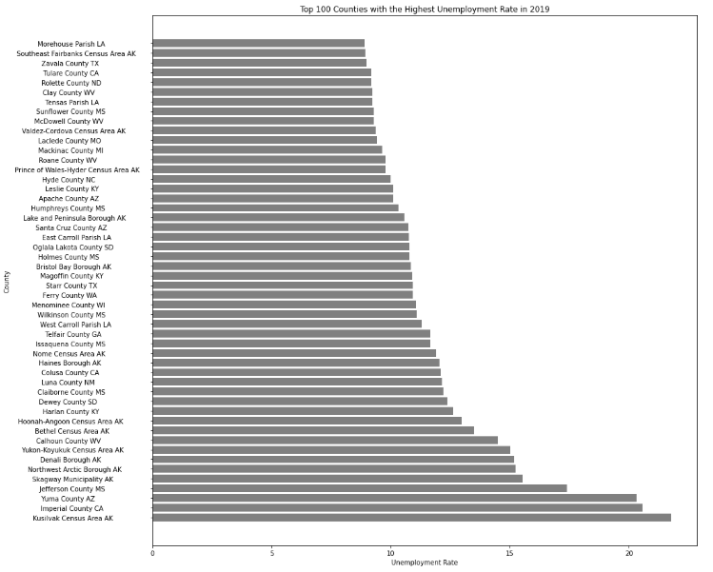
Bar chart (2019 data)

Slide 9
Bar chart (2019 data)
Bar chart shows Kusilvak Census Area (AK) had the highest unemployment rate in 2019 followed by imperial county, CA
More than 100 counties had unemployment rate of greater than 12% in 2019

Slide 10
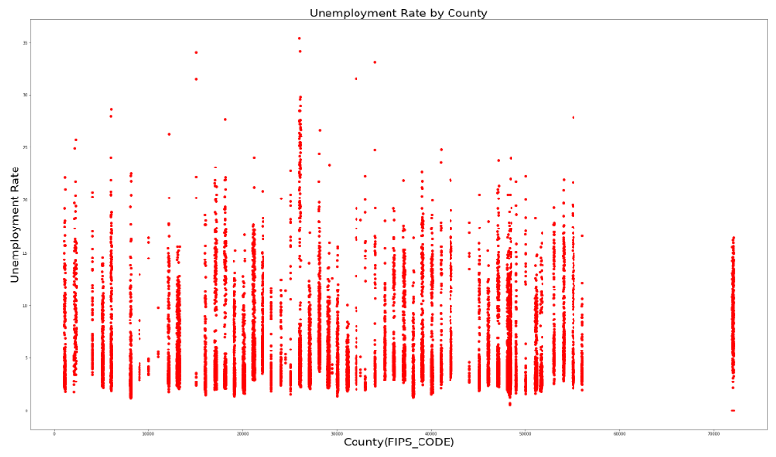
Scatter plot (2020 data)
Unemployment rate is not uniform for many counties
There a few outliers with a very high unemployment rate

Slide 11
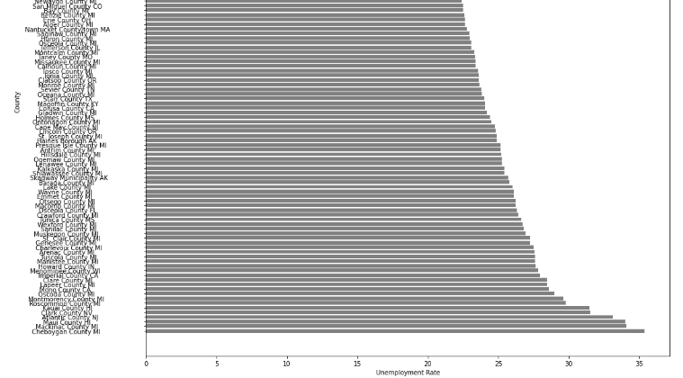
Bar Chart (2020 data)

Slide 12
Bar chart
Forty out of top 100 counties with the highest unemployment belong to MI
Around 450 counties have an unemployment rate of 2 percent
The unemployment rates have been doubled for top 100 counties

Slide 13
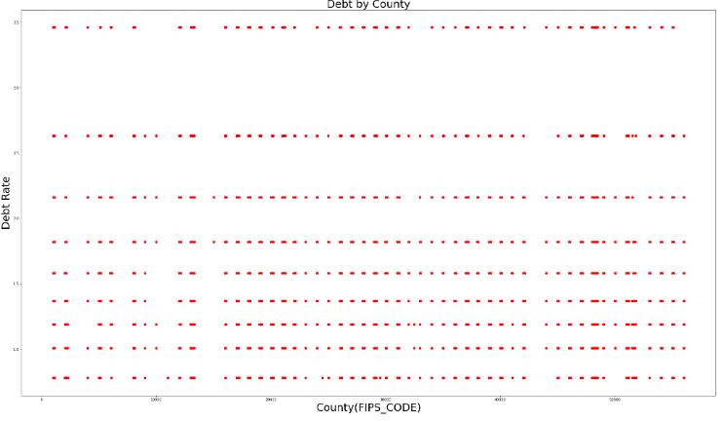
Scatter plot (2019 data)

Slide 14
Scatter plot (2019 data)
Scatter plot-3 shows the debt rates were high for many counties in 2019
The debt rates on the rise from quarter-1 to quarter-4 in 2019

Slide 15
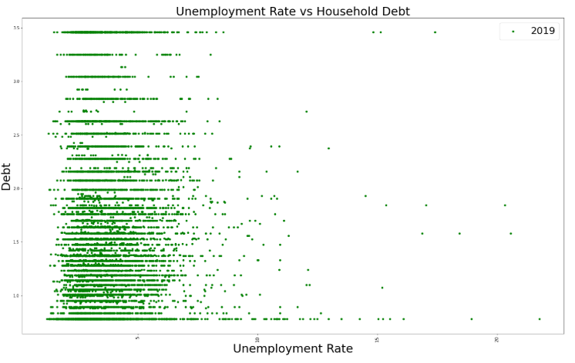
Scatter Plot

Slide 16
Predictive Modeling
Correlation analysis between unemployment and debt rate of all counties
Regression analysis to find the debt rate based on unemployment
Measured Pearson and Spearman coefficients
Measured accuracy of the linear regression model

Slide 17
Results
Pearson and Correlation coefficients (- 0.0280)
Spearman coefficient value - 0.016
Accuracy of the regression model - 0.012

Slide 18
Conclusions
No correlation exists between the unemployment rate and debt rate
Other factors not part of the study are impacting household debt
Unemployment has almost doubled from 2019 to 2020
Household debt is steadily rising across all counties
Some counties have low unemployment rate

Slide 19
Acknowledgments
Sincere thanks to Professor Fadi Alsaleem for his support
Classmates for their review, and feedback

